Slide 1
ARGO – HOPPER Clusters Usage Statistics 2020 - 2022

Slide 2
Contents
Overview
Accounts requested and trained
All Jobs run
GPUs vs CPUs
Multi Core Vs. Single Core Jobs
Job Exit States
Monthly Usage Stats
Argo Usage
GPU Jobs: Cumulative Usage Numbers
GPU Jobs: Breakdown by School/Department
CPU Jobs: Cumulative Usage Numbers
CPU Jobs: Breakdown by School/Department
Hopper Usage
GPU Jobs: Cumulative Usage Numbers
GPU Jobs: Breakdown by School/Department
CPU Jobs: Cumulative Usage Numbers
CPU Jobs: Breakdown by School/Department

Slide 3
Cluster Account Requests and Training

Slide 4
Cluster Account Requests and Training
In the following slides, the numbers for users requesting accounts over the period 2019 – 2022 are broken down.
The tables and figures show how the account requests are distributed based on the origination school/college of the researcher.
Additional slides break down the numbers for student researchers attending the new user tutorial for the different months in 2022.
In general, the CEC and COS have most requests for cluster accounts.
The number of requested account does not necessarily correspond to the number of users trained as some users take time before they actually attend the tutorial sessions to start using the cluster.

Slide 5
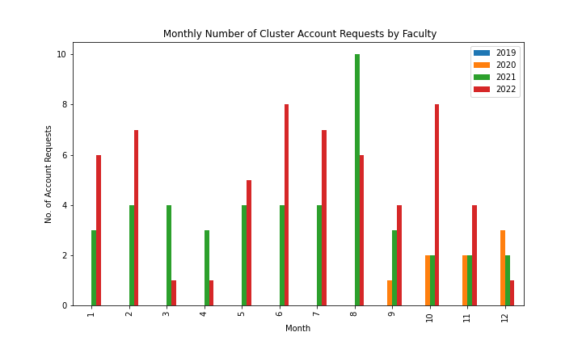
Cluster Account Requests by Faculty 2019 - 2022
Total account requests from faculty for cluster accounts for every month
Total account requests from faculty by School/College
Month | 2019 | 2020 | 2021 | 2022
1 | 0 | 0 | 3 | 6
2 | 0 | 0 | 4 | 7
3 | 0 | 0 | 4 | 1
4 | 0 | 0 | 3 | 1
5 | 0 | 0 | 4 | 5
6 | 0 | 0 | 4 | 8
7 | 0 | 0 | 4 | 7
8 | 0 | 0 | 10 | 6
9 | 0 | 1 | 3 | 4
10 | 0 | 2 | 2 | 8
11 | 0 | 2 | 2 | 4
12 | 0 | 3 | 2 | 1
Total | 0 | 8 | 45 | 58
College | No. of Requests 2020
CEC | 4
COS | 4
College | No. of Requests 2021
CEC | 19
CHHS | 2
CHSS | 4
COS | 14
SCHAR | 3
SMSC | 1
SOM | 2
College | No. of Requests 2022
CEC | 21
CHSS | 4
COS | 26
ORC | 2
SOM | 5

Slide 6
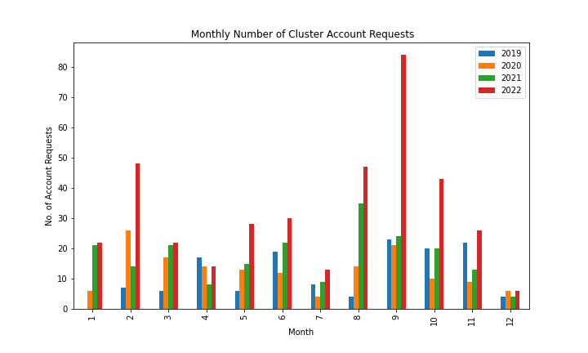
Cluster Accounts Requested by Students Each month 2019 - 2022
 | Year
Month | 2019 | 2020 | 2021 | 2022
1 | 0 | 6 | 21 | 22
2 | 7 | 26 | 14 | 48
3 | 6 | 17 | 21 | 22
4 | 17 | 14 | 8 | 14
5 | 6 | 13 | 15 | 28
6 | 19 | 12 | 22 | 30
7 | 8 | 4 | 9 | 13
8 | 4 | 14 | 35 | 47
9 | 23 | 21 | 24 | 84
10 | 20 | 10 | 20 | 43
11 | 22 | 9 | 13 | 26
12 | 4 | 6 | 4 | 6
Total | 136 | 152 | 206 | 383

Slide 7
Cluster Accounts Requested by Students arranged by School/College 2019 – 2022
College | No. of Requests 2019
CEC | 104
CHSS | 4
COS | 28
College | No. of Requests 2020
CEC | 98
CHSS | 12
COS | 40
SCHAR | 2
College | No. of Requests 2021
CEC | 131
CHHS | 1
CHSS | 13
COS | 60
ORC | 1
College | No. of Requests 2022
CEC | 306
CEHD | 1
CHHS | 2
CHSS | 9
COS | 65

Slide 8
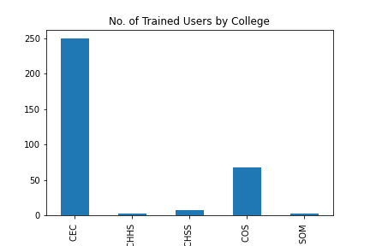
Students trained by School/College in 2022
 | School/College
Month | CEC | CHHS | CHSS | COS | SOM
1 | 4 | 0 | 0 | 2 | 0
2 | 36 | 0 | 0 | 10 | 0
3 | 23 | 0 | 2 | 2 | 0
4 | 10 | 0 | 1 | 4 | 0
5 | 3 | 1 | 0 | 4 | 0
6 | 23 | 0 | 2 | 9 | 0
7 | 4 | 1 | 0 | 6 | 0
8 | 7 | 0 | 1 | 12 | 2
9 | 79 | 0 | 0 | 5 | 0
10 | 35 | 1 | 1 | 2 | 0
11 | 16 | 0 | 0 | 7 | 0
12 | 10 | 0 | 0 | 5 | 0
TOTAL | 250 | 3 | 7 | 68 | 2

Slide 9
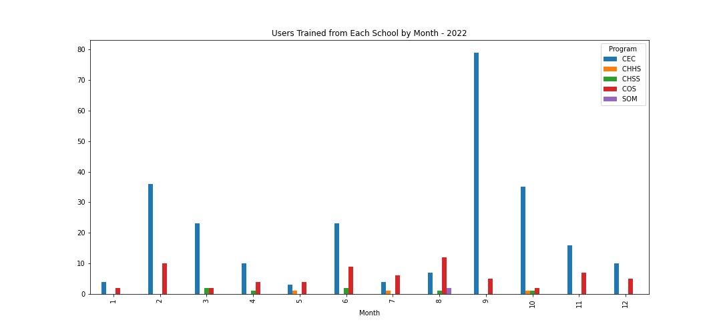
Students trained per month by School/College in 2022

Slide 10
Summary of Usage Numbers

Slide 11
Total number of Jobs Run on both Argo and Hopper
Year | Argo | Hopper
2020 | 3080997 | 0
2021 | 424030 | 178120
2022 | 364032 | 1179007
- The table summarizes the usage of the clusters across the different years, with an increasing number of jobs being submitted to Hopper as opposed to ARGO.
The number of jobs on Hopper crossed the 1M mark in 2022 as more researchers and new users were added to Hopper.
The high number of jobs in 2020 on Argo were driven by researchers from the Statistics department and the Cybersecurity and Engineering Department submitting array jobs.

Slide 12
GPU/CPU Jobs – Single Core vs. Multi-Core
From all the jobs that ran, we look at jobs that was ran on either a single processor (core) or across multiple processors.
Across 2020 – 2022, the majority of jobs are single-core and run on CPUs on Argo.
On Hopper, we had more multi-core CPU jobs in 2021. For 2022 single-core CPU runs roughly matched multi-core cpu runs.
Most of the gpu runs were multi-core on Hopper in 2022.
ARGO | GPU Jobs |  | CPU Jobs
Year | multi-core gpu runs | single-core gpu runs | multi-core cpu runs | single-core cpu runs | TOTAL
2020 | 3475 | 142317 | 146293 | 2788912 | 3080997
2021 | 10451 | 105696 | 76908 | 230426 | 423481
2022 | 5118 | 10445 | 124442 | 224034 | 364039
HOPPER | GPU Jobs |  | CPU Jobs
Year | multi-core gpu runs | single-core gpu runs | multi-core cpu runs | single-core cpu runs | TOTAL
2020 | 0 | 0 | 0 | 0 | 0
2021 | 1750 | 2233 | 105627 | 68480 | 178097
2022 | 114249 | 33938 | 512936 | 517884 | 1179007

Slide 13
Jobs Submitted by School/Colleges
In the following tables and figures, we have the number of jobs submitted broken down by originating school/college.
The jobs submissions come from a variety of schools, including the College of Science, College of Engineering and Computing, the School of Business (SOM) and SCHAR, and their usage changes from year to year.
On Hopper, usage includes non-traditional schools such as LAW and VPA.
The CEC and COS consistently have the most jobs submitted on both Hopper and ARGO across the 3 years.

Slide 14
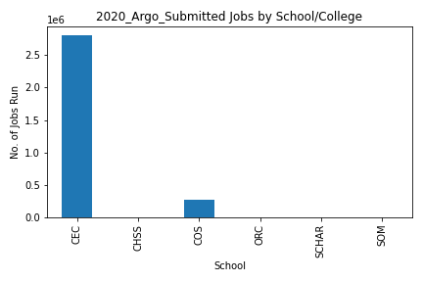
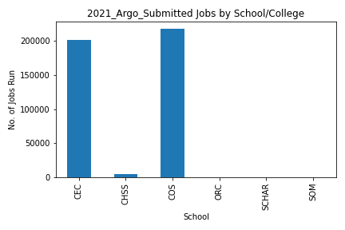
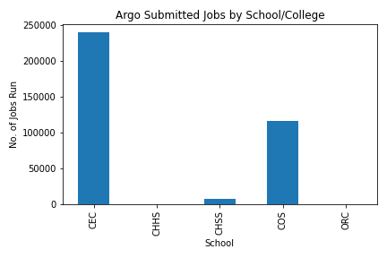
All Jobs Submitted by School/College: ARGO
College | 2020 All ARGO Submits
CEC | 2806615
CHSS | 4757
COS | 268607
ORC | 859
SCHAR | 46
SOM | 108
TOTAL | 3080992
College | 2021 All ARGO Submits
CEC | 201139
CHSS | 4608
COS | 218049
ORC | 69
SCHAR | 24
SOM | 17
TOTAL | 423906
College | 2022 All ARGO Submits
CEC | 239489
CHHS | 75
CHSS | 7890
COS | 116480
ORC | 98
TOTAL | 364032

Slide 15
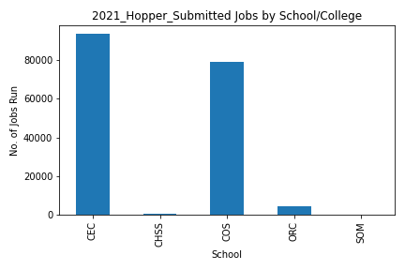
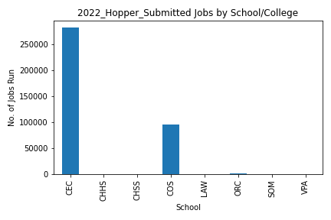
All Jobs Submitted by School/College: Hopper
College | 2021 All Hopper Submits
CEC | 93440
CHSS | 827
COS | 79077
ORC | 4541
SOM | 7
TOTAL | 177892
College | 2022 All Hopper Submits
CEC | 772413
CHHS | 15621
CHSS | 8007
COS | 376035
ITS | 20
LAW | 246
ORC | 6065
SOM | 591
VPA | 9
TOTAL | 1179007

Slide 16
Jobs Exit States
Once submitted, jobs on the cluster can have various exit states:
COMPLETE – they run to completion
FAILED – They run for some time and then fail to complete successfully
CANCELLED – they get cancelled before they either COMPLETE or FAIL
TIMEOUT – they run but hit the set time limit so do not complete
OUT_OF_MEMORY – they fail because not enough memory was set
NODE_FAIL – the node itself crashes for some reason
PREEMPTED – they were stopped to allow higher priority jobs
REQUEUED – they were stopped and sent back to the Queue
*We had about 20 runaway jobs (status stays ‘RUNNING’ even after they’re done and nodes are idle)
The total number of jobs run counts all jobs regardless of completion state
In the next slides, we see that the majority of jobs run to completion. Most of the jobs that do not complete – get cancelled or fail, are normally restarted.

Slide 17
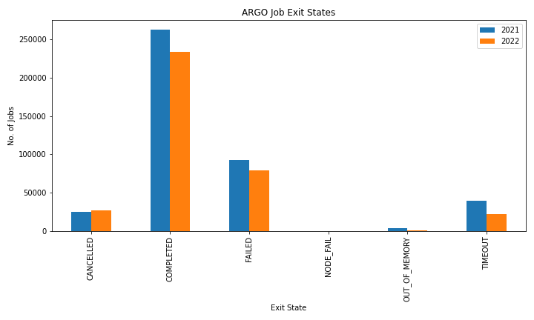
Exit States for all Jobs on ARGO [2021, 2022]
State | 2021 | 2022
CANCELLED | 25528 | 27152
COMPLETED | 262030 | 233741
FAILED | 93074 | 79633
NODE_FAIL | 14 | 4
OUT_OF_MEMORY | 3780 | 878
TIMEOUT | 39604 | 22624
Totals | 424030 | 364032

Slide 18
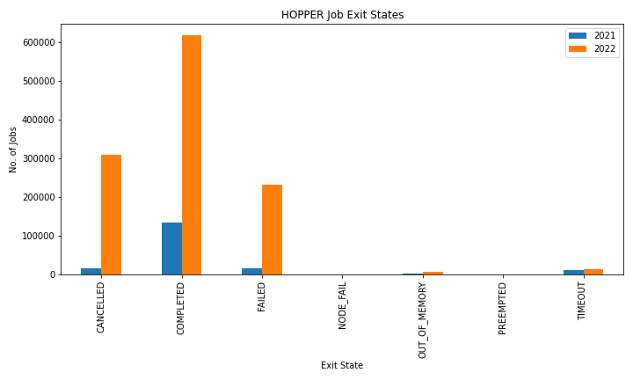
Exit States for all Jobs on HOPPER [2021, 2022]
State | 2021 | 2022
CANCELLED | 16083 | 309437
COMPLETED | 133811 | 618112
FAILED | 15341 | 232339
NODE_FAIL | 4 | 42
OUT_OF_MEMORY | 1561 | 5905
PREEMPTED | 154 | 379
TIMEOUT | 11166 | 12773
Totals | 178120 | 1178987

Slide 19
Monthly Usage Stats
The following figures display the number of active users submitting jobs on ARGO and Hopper for the different months between 2020 -2022. On HOPPER, for 2021 and 2022, we can see a pattern emerging for the number of unique users submitting jobs with a peak around October/November.

Slide 20
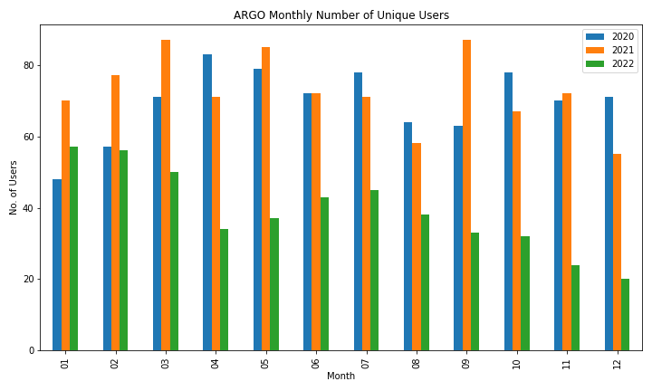
ARGO Active Users Monthly 2020-2021
Month | 2020 | 2021 | 2022
1 | 48 | 70 | 57
2 | 57 | 77 | 56
3 | 71 | 87 | 50
4 | 83 | 71 | 34
5 | 79 | 85 | 37
6 | 72 | 72 | 43
7 | 78 | 71 | 45
8 | 64 | 58 | 38
9 | 63 | 87 | 33
10 | 78 | 67 | 32
11 | 70 | 72 | 24
12 | 71 | 55 | 20

Slide 21
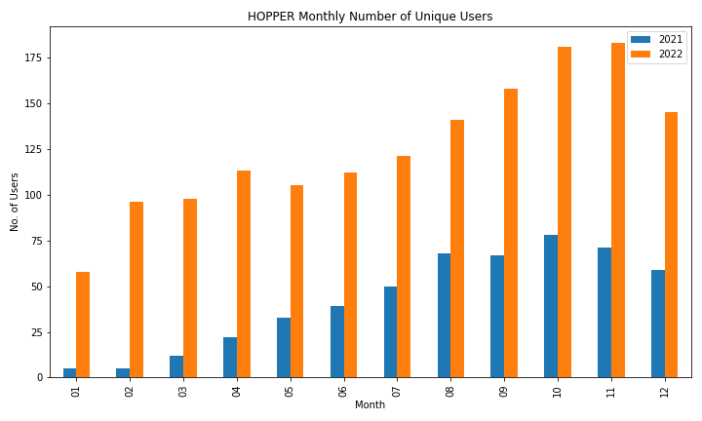
HOPPER Active Users Monthly 2021-2022
Month | 2021 | 2022
1 | 5 | 58
2 | 5 | 96
3 | 12 | 98
4 | 22 | 113
5 | 33 | 105
6 | 39 | 112
7 | 50 | 121
8 | 68 | 141
9 | 67 | 158
10 | 78 | 181
11 | 71 | 183
12 | 59 | 145

Slide 22
ARGO

Slide 23
GPU Usage by School/College
The next figures and tables break down the GPU usage by the Colleges/schools over the three years.
Again, it is clear that most gpu jobs were run by researchers from the CEC and COS.

Slide 24
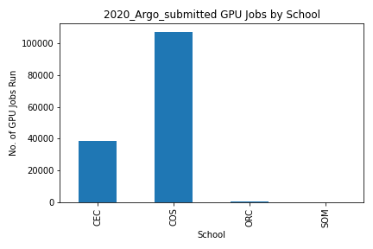
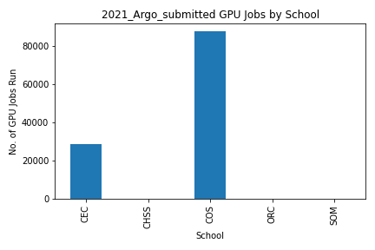
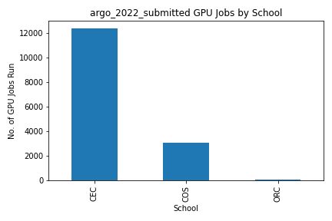
GPU Usage by School/College
College | Argo 2020 GPU Submits
CEC | 38302
COS | 107410
ORC | 79
SOM | 1
TOTAL | 145792
College | Argo 2021 GPU Submits
CEC | 28562
CHSS | 26
COS | 87511
ORC | 31
SOM | 17
TOTAL | 116147
College | Argo 2022 GPU Submits
CEC | 12404
COS | 3091
ORC | 68
TOTAL | 15563

Slide 25
ARGO GPU Usage by department
The next tables show the accounting information for ARGO over the 3 years for GPU jobs submitted from the different departments.
The tables give yearly totals for how many jobs each department submitted (No. of Submits), how many hours they ran for (Runtime counted hours), how many CPUS and GPUS they used, and how much memory they used (in GB) over each year.

Slide 26
GPU Usage by department: ARGO 2020
Department | All Jobs Submitted | Cumulative RunTime (Hrs) | No. of CPUS used | No. of GPUS used | Total Memory used in GB
Data Analytics and Engineering | 473 | 1657 | 473 | 605 | 18362
Department of Biology | 104271 | 8613 | 104271 | 105282 | 6290878
Department of Chemistry and Biochemistry | 381 | 414 | 413 | 381 | 2222
Department of Computational and Data Sciences | 2323 | 50435 | 14586 | 2878 | 451588
Department of Computer Science | 19482 | 78594 | 48991 | 23370 | 41966418
Department of Electrical and Computer Engineering | 7059 | 9408 | 7843 | 7065 | 23105123
Department of Information Sciences and Technology | 115 | 260 | 160 | 137 | 2104358
Department of Mathematical Sciences | 154 | 62 | 154 | 266 | 1147
Department of Mechanical Engineering | 23 | 42 | 134 | 23 | 509
Department of Physics and Astronomy | 70 | 141 | 70 | 66 | 1126
Department of Systems Engineering and Operations Research | 10961 | 7944 | 10961 | 11051 | 8711
Office of Research Computing | 79 | 25 | 133 | 89 | 1421
School of Business | 1 | 0 | 1 | 1 | 2
School of Systems Biology | 211 | 157 | 3867 | 693 | 275338
Department of Civil, Environmental, and Infrastructure Engineering | 189 | 325 | 227 | 214 | 6188
TOTALS | 145792 | 158077 | 192284 | 152121 | 74233391

Slide 27
GPU Usage by department: ARGO 2021
Department | All Jobs Submitted | Cumulative RunTime (Hrs) | No. of CPUS used | No. of GPUS used | Total Memory used in GB
Data Analytics and Engineering | 18 | 93 | 92 | 50 | 1216
Department of Biology | 74616 | 10326 | 75351 | 74536 | 4855065
Department of Chemistry and Biochemistry | 41 | 151 | 43 | 82 | 477
Department of Computational and Data Sciences | 5069 | 27789 | 37841 | 4649 | 80282
Department of Computer Science | 20540 | 82341 | 56438 | 24740 | 2478570
Department of Electrical and Computer Engineering | 1269 | 4332 | 5050 | 1213 | 302686
Department of Environmental Science and Policy | 1 | 27 | 24 | 1 | 300
Department of Geography and Geoinformation Science | 14 | 2 | 14 | 12 | 27
Department of History and Art History | 26 | 525 | 26 | 57 | 2068
Department of Information Sciences and Technology | 6566 | 2180 | 8134 | 6518 | 220816
Department of Mathematical Sciences | 7483 | 9491 | 7491 | 7639 | 33428
Department of Mechanical Engineering | 15 | 239 | 150 | 15 | 1611
Department of Systems Engineering and Operations Research | 25 | 35 | 64 | 15 | 462
Office of Research Computing | 31 | 2 | 368 | 37 | 1280
School of Business | 17 | 42 | 56 | 13 | 234
School of Systems Biology | 287 | 7252 | 5922 | 800 | 11844
Department of Civil, Environmental, and Infrastructure Engineering | 129 | 420 | 129 | 128 | 4720
TOTALS | 116147 | 145247 | 197193 | 120505 | 7995086

Slide 28
GPU Usage by department: ARGO 2022
Department | All Jobs Submitted | CoreHours | GPUHours | No. of CPUS used | No. of GPUS used | Total Memory in GB
Department of Biology | 1902 | 4621.51 | 4642.23 | 1902 | 1877 | 86393
Department of Chemistry and Biochemistry | 21 | 104.18 | 416.55 | 21 | 56 | 333
Department of Computational and Data Sciences | 1074 | 81422.48 | 12812.25 | 6888 | 1026 | 13776
Department of Computer Science | 11749 | 232019.84 | 106051.91 | 42307 | 17774 | 58731456
Department of Electrical and Computer Engineering | 44 | 35.89 | 135.17 | 44 | 128 | 3184
Department of Information Sciences and Technology | 601 | 656.03 | 619.13 | 604 | 592 | 18862
Department of Mathematical Sciences | 19 | 36.45 | 36.45 | 19 | 16 | 335
Department of Physics and Astronomy | 16 | 10228.01 | 10.01 | 800 | 11 | 781
Department of Statistics | 10 | 11.83 | 1.59 | 73 | 10 | 194
Office of Research Computing | 68 | 341.93 | 146.34 | 642 | 171 | 3777
School of Systems Biology | 59 | 96761.61 | 11311.36 | 1056 | 118 | 2112
TOTALS | 15563 | 426239.76 | 136183.00 | 54356 | 21779 | 58861203

Slide 29
ARGO CPU Usage by School/College
The same holds true for CPU usage on ARGO. From the following tables and figures, most CPU jobs were run by researchers from COS and CEC.
Further break down of the CPU job usage metrics show the actual departments in both the CEC and COS and how much they used the clusters in terms of the total number of jobs submitted, total runtime in hours, total number of CPUs used and total memory in GB.
The figures cover the 3 years. In 2020, a large number of jobs were submitted from the Statistics department followed by the Cyber Security Engineering (driven by the top users).

Slide 30
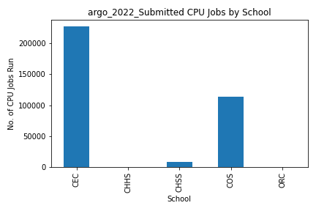
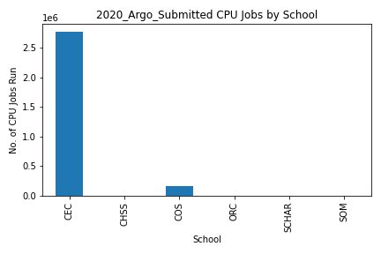
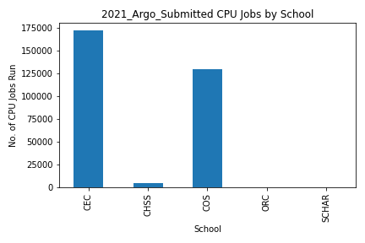
ARGO CPU Usage by School/College
College | Argo 2020 CPU Submits
CEC | 2768313
CHSS | 4757
COS | 161197
ORC | 780
SCHAR | 46
SOM | 107
TOTALS | 2935200
College | Argo 2021 CPU Submits
CEC | 172577
CHSS | 4582
COS | 129989
ORC | 38
SCHAR | 24
TOTALS | 307210
College | Argo 2022 CPU Submits
CEC | 227085
CHHS | 75
CHSS | 7890
COS | 113295
ORC | 30
TOTALS | 348375

Slide 31
ARGO CPU Usage by Department in CEC/COS: 2022
Department | No. of Jobs | CoreHours | No. of CPUs used | Total Memory used in GB
Department of Atmospheric, Oceanic and Earth Sciences | 226 | 140902.15 | 20748 | 68940
Department of Biology | 451 | 169024.32 | 5830 | 15636
Department of Chemistry and Biochemistry | 50 | 124541.35 | 2617 | 2978
Department of Computational and Data Sciences | 6741 | 84608.94 | 109679 | 97173
Department of Computer Science | 155023 | 81814.35 | 287354 | 13991573
Department of Electrical and Computer Engineering | 693 | 151716.84 | 6752 | 4283140
Department of Environmental Science and Policy | 46 | 2371.37 | 427 | 436
Department of Geography and Geoinformation Science | 872 | 79127.74 | 4155 | 6601
Department of Global and Community Health | 75 | 4.39 | 330 | 804
Department of Information Sciences and Technology | 77 | 9883.81 | 385 | 77
Department of Mathematical Sciences | 16010 | 25704.13 | 16010 | 79165
Department of Mechanical Engineering | 132 | 1585.44 | 267 | 554
Department of Physics and Astronomy | 88889 | 4785900.09 | 2551359 | 4837804
Department of Psychology | 7890 | 77541.32 | 45981 | 126682
Department of Statistics | 62019 | 84128.51 | 65150 | 1141992
Department of Systems Engineering and Operations Research | 5475 | 2966.05 | 5528 | 93
Office of Research Computing | 30 | 45.00 | 222 | 509
School of Systems Biology | 10 | 185.54 | 109 | 270
Sid and Reva Dewberry Department of Civil, Environmental, and Infrastructure Engineering | 3666 | 86215.17 | 14952 | 24309
TOTALS | 348375 | 5908266.51 | 3137855 | 24678736

Slide 32
Next, details are provided for the CEC and COS Colleges since they contain the most jobs submitted.
Breaking it down further, the following tables and figures show the number of submissions from the departments in the CEC and COS colleges for 2022.

Slide 33
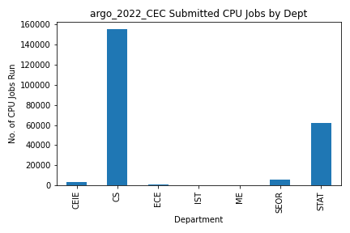
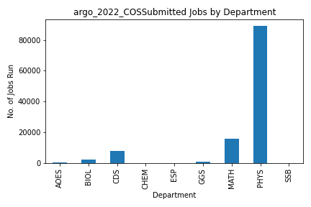
Department | Dept | 2020 Argo Runs | College
Department of Civil, Environmental, and Infrastructure Engineering | CEIE | 3666 | CEC
Department of Computer Science | CS | 155023 | CEC
Department of Electrical and Computer Engineering | ECE | 693 | CEC
Department of Information Sciences and Technology | IST | 77 | CEC
Department of Mechanical Engineering | ME | 132 | CEC
Department of Systems Engineering and Operations Research | SEOR | 5475 | CEC
Department of Statistics | STAT | 62019 | CEC
 | Total | 227085
Department | Dept | 2020 Argo Runs | College
Department of Atmospheric, Oceanic and Earth Sciences | AOES | 226 | COS
Department of Biology | BIOL | 2353 | COS
Department of Computational and Data Sciences | CDS | 7815 | COS
Department of Chemistry and Biochemistry | CHEM | 71 | COS
Department of Environmental Science and Policy | ESP | 46 | COS
Department of Geography and Geoinformation Science | GGS | 872 | COS
Department of Mathematical Sciences | MATH | 16029 | COS
Department of Physics and Astronomy | PHYS | 88999 | COS
School of Systems Biology | SSB | 69 | COS
 | Total | 116480

Slide 34
HOPPER

Slide 35
Hopper Usage
Moving on to Hopper, the following tables and figures break down similar details on the gpu and cpu usage and the different departments and colleges running jobs.
While it holds true that the CEC and COS drive most jobs on Hopper, the CEC has the most jobs over the two years, 2021 – 2022 that Hopper has been active.
Most GPU usage is from the CS department, in terms of the hours and CPUs and GPUs used. This holds for both 2021 and 2022.

Slide 36
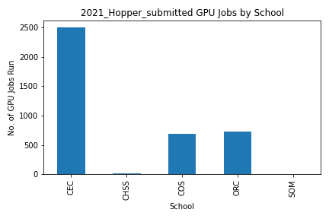
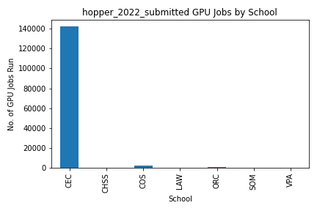
Hopper GPU Usage by College/School
College | Hopper 2021 GPU Runs
CEC | 2492
CHSS | 20
COS | 694
ORC | 729
SOM | 4
TOTAL | 3939
College | Hopper 2022 GPU Runs
CEC | 141930
CHSS | 3
COS | 2580
LAW | 1
ORC | 694
SOM | 36
VPA | 9
TOTAL | 145253

Slide 37
GPU Usage by Department Hopper 2021
Department | All Jobs Submitted | CoreHours | GPUHours | No. of CPUS used | No. of GPUS used | Total Memory used in GB
Data Analytics and Engineering | 2 | 72 | 3 | 24 | 1 | 48
Department of Bioengineering | 321 | 34026 | 16430 | 321 | 155 | 12929
Department of Chemistry and Biochemistry | 1 | 4 | 1 | 4 | 1 | 8
Department of Computational and Data Sciences | 244 | 8246385 | 826588 | 2115 | 212 | 4322
Department of Computer Science | 1847 | 34483164 | 12314376 | 4738 | 1692 | 189589
Department of Cyber Security Engineering | 74 | 882426 | 19764 | 2411 | 54 | 22144
Department of Electrical and Computer Engineering | 74 | 36207 | 4698 | 447 | 58 | 5011
Department of Geography and Geoinformation Science | 315 | 144780 | 45524 | 1905 | 599 | 29212
Department of Information Sciences and Technology | 140 | 482670 | 115218 | 465 | 111 | 2439
Department of Mathematical Sciences | 6 | 0 | 0 | 6 | 4 | 20
Department of Physics and Astronomy | 6 | 0 | 0 | 20 | 3 | 635
Department of Sociology and Anthropology | 20 | 42 | 19 | 42 | 19 | 1528
Department of Systems Engineering and Operations Research | 12 | 0 | 0 | 27 | 8 | 133
Office of Research Computing | 729 | 716958 | 138159 | 4686 | 903 | 26962
School of Business | 4 | 0 | 0 | 13 | 1 | 46
School of Systems Biology | 122 | 1533600 | 97200 | 2272 | 144 | 7738
Department of Civil, Environmental, and Infrastructure Engineering | 22 | 810 | 648 | 30 | 24 | 280
TOTAL | 3939 | 46561144 | 13578628 | 19526 | 3989 | 303044

Slide 38
GPU Usage by Department Hopper 2022
Department | All Jobs Submitted | CoreHours | GPUHours | No. of CPUs used | No. of GPUs used | Total Memory used in GB
Data Analytics and Engineering | 938 | 42429.52 | 4098.60 | 22008 | 1451 | 150200
Department of Atmospheric, Oceanic and Earth Sciences | 436 | 191477.66 | 11969.54 | 25114 | 1351 | 173197
Department of Bioengineering | 1605 | 1311.71 | 1291.31 | 1636 | 1537 | 32853
Department of Chemistry and Biochemistry | 16 | 30.45 | 4.09 | 66 | 16 | 596
Department of Computational and Data Sciences | 324 | 17664.38 | 2266.93 | 2800 | 357 | 7771
Department of Computer Science | 125132 | 1108249.52 | 182398.41 | 1916238 | 120161 | 23515173
Department of Criminology, Law and Society | 2 | 0.23 | 0.12 | 4 | 2 | 8
Department of Cyber Security Engineering | 23 | 72.88 | 6.08 | 422 | 20 | 948
Department of Economics | 1 | 5.55 | 5.55 | 1 | 1 | 50
Department of Electrical and Computer Engineering | 404 | 119264.41 | 16411.43 | 6952 | 1086 | 70036
Department of Environmental Science and Policy | 33 | 71.09 | 59.85 | 83 | 31 | 4689
Department of Geography and Geoinformation Science | 959 | 9415.00 | 3286.06 | 6853 | 1620 | 139995
Department of Information Sciences and Technology | 13725 | 145039.79 | 8341.85 | 26628 | 13832 | 245829
Department of Mathematical Sciences | 11 | 0.32 | 0.23 | 20 | 11 | 664
Department of Mechanical Engineering | 2 | 40.06 | 2.50 | 32 | 2 | 64
Department of Physics and Astronomy | 796 | 14635.51 | 964.00 | 8921 | 819 | 63778
Department of Statistics | 1 | 0.01 | 0.00 | 2 | 1 | 4
Department of Systems Engineering and Operations Research | 51 | 13424.60 | 754.79 | 662 | 54 | 3662
Office of Research Computing | 694 | 3694.55 | 385.09 | 10998 | 632 | 64026
School of Business | 36 | 924.23 | 101.20 | 347 | 39 | 2098
School of Law | 1 | 0.04 | 0.02 | 2 | 1 | 4
School of Music | 9 | 8.39 | 2.37 | 13 | 8 | 130
School of Systems Biology | 5 | 58.01 | 4.83 | 132 | 5 | 403
Department of Civil, Environmental, and Infrastructure Engineering | 49 | 1515.42 | 117.67 | 609 | 44 | 3250
TOTAL | 145253 | 1669333.35 | 232472.55 | 2030543 | 143081 | 24479428

Slide 39
Hopper CPU Usage
The next tables and figures show how the CPUs on Hopper are being used.
We see the CEC and COS leading in usage. In 2021, most CPUs were used by the Bioengineering Department followed by the Computer Science Department.
In 2022, we see the Statistics Department usage picking up, as well as the ECE and CS departments.
From the COS, most use is by the AOES, Physics, CDS and Chemistry departments.

Slide 40
CPU Usage by Department Hopper 2021
CEC Department | No. of Jobs Submitted | Cumulative RunTime (Hrs) | No. of CPUS Used | Total Memory Used (GB)
Data Analytics and Engineering | 32 | 21 | 95 | 194
Department of Bioengineering | 16672 | 12500 | 101578 | 218779
Department of Computer Science | 37441 | 90009 | 41532 | 360534
Department of Cyber Security Engineering | 203 | 1668 | 10627 | 39247
Department of Electrical and Computer Engineering | 1153 | 4274 | 221809 | 592901
Department of Information Sciences and Technology | 121 | 320 | 616 | 5816
Department of Statistics | 27692 | 329284 | 108828 | 360848
Department of Systems Engineering and Operations Research | 54 | 858 | 1343 | 1548
Department of Civil, Environmental, and Infrastructure Engineering | 7580 | 30637 | 24743 | 141622
TOTAL | 90948 | 469571 | 511171 | 1721489
COS Department | No. of Jobs Submitted | Cumulative RunTime (Hrs) | No. of CPUS Used | Total Memory Used (GB)
Department of Atmospheric, Oceanic and Earth Sciences | 18409 | 29299 | 2183054 | 4398352
Department of Biology | 461 | 2481 | 16962 | 114609
Department of Chemistry and Biochemistry | 366 | 2303 | 17091 | 74196
Department of Computational and Data Sciences | 1157 | 14274 | 25517 | 67919
Department of Environmental Science and Policy | 103 | 219 | 4116 | 25337
Department of Geography and Geoinformation Science | 83 | 127 | 692 | 1236
Department of Mathematical Sciences | 360 | 7241 | 3117 | 14139
Department of Physics and Astronomy | 57417 | 25243 | 992613 | 3911920
School of Systems Biology | 19 | 5 | 314 | 640
TOTAL | 78375 | 81192 | 3243476 | 8608348

Slide 41
CPU Usage by Department Hopper 2022
Department | No. of Jobs Submitted | CoreHours | No. of CPUs used | Total Memory in GB
Data Analytics and Engineering | 427 | 4942.33 | 1919 | 6016
Department of Atmospheric, Oceanic and Earth Sciences | 97898 | 4225800.00 | 4650374 | 15249948
Department of Bioengineering | 12714 | 33388.43 | 16086 | 53018
Department of Biology | 434 | 133751.04 | 10802 | 89031
Department of Chemistry and Biochemistry | 69000 | 781653.60 | 323810 | 1152018
Department of Computational and Data Sciences | 2886 | 618718.09 | 30376 | 64817
Department of Computer Science | 284762 | 750871.33 | 2079820 | 13408189
Department of Criminology, Law and Society | 26 | 47.26 | 212 | 648
Department of Cyber Security Engineering | 53 | 12706.94 | 1988 | 47908
Department of Economics | 722 | 57350.36 | 8016 | 31430
Department of Electrical and Computer Engineering | 64094 | 2566719.22 | 184170 | 708529
Department of English | 404 | 42129.60 | 5557 | 121459
Department of Environmental Science and Policy | 16 | 93.64 | 47 | 121
Department of Geography and Geoinformation Science | 1480 | 13297.49 | 37204 | 125252
Department of Global and Community Health | 15621 | 4688.30 | 187083 | 747872
Department of Information Sciences and Technology | 1791 | 484596.24 | 29776 | 156097
Department of Mathematical Sciences | 2010 | 444430.11 | 47352 | 420468
Department of Mechanical Engineering | 7 | 958.28 | 104 | 232
Department of Physics and Astronomy | 199674 | 6644592.97 | 9095182 | 37591423
Department of Psychology | 6852 | 11990.61 | 38397 | 216001
Department of Statistics | 253527 | 938674.38 | 291694 | 2787176
Department of Systems Engineering and Operations Research | 1560 | 567069.12 | 81810 | 54170
Information Technology Services | 20 | 188.32 | 56 | 156
Office of Research Computing | 2275 | 59325.26 | 83233 | 461870
School of Business | 555 | 36158.57 | 4378 | 37094
School of Law | 245 | 13537.52 | 5284 | 94709
School of Systems Biology | 57 | 24809.90 | 2680 | 10114
Sid and Reva Dewberry Department of Civil, Environmental, and Infrastructure Engineering | 11548 | 322727.62 | 70131 | 856686
TOTAL | 1030658 | 18795216.54 | 17287541 | 74492452

Slide 42
The next tables and figures show submission numbers for CPU jobs on Hopper broken down by the originating School/College of the researcher and then further by the respective departments for both 2021 and 2022.
A further breakdown is given on the Departments from the CEC which had the most runs submitted to Hopper

Slide 43
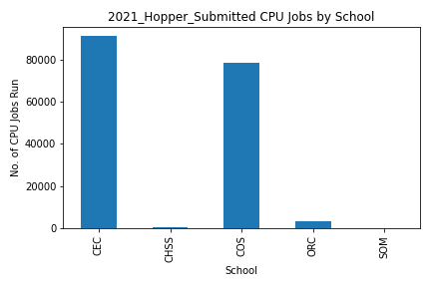
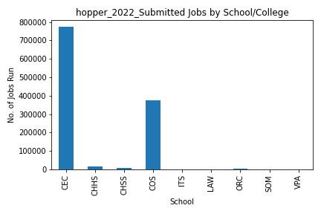
Hopper CPU Jobs by School/College
College | Hopper 2021 CPU Runs
CEC | 90948
CHSS | 807
COS | 78375
ORC | 3647
SOM | 3
TOTAL | 173780
College | Hopper 2022 CPU Runs
CEC | 630483
CHHS | 15621
CHSS | 8004
COS | 373455
ITS | 20
LAW | 245
ORC | 2275
SOM | 555
TOTAL | 1030658

Slide 44
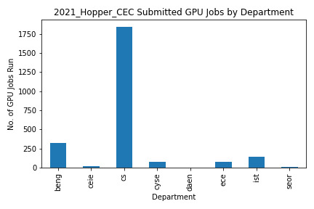
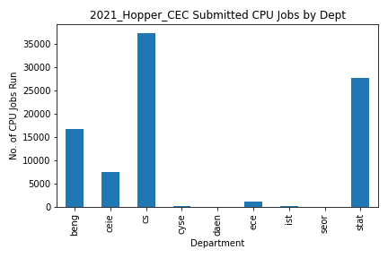
Hopper jobs by Department in CEC : 2021
Department | Dept | 2021 Hopper GPU Runs | College
Department of Bioengineering | BENG | 321 | CEC
Department of Civil, Environmental, and Infrastructure Engineering | CEIE | 22 | CEC
Department of Computer Science | CS | 1847 | CEC
Department of Cyber Security Engineering | CYSE | 74 | CEC
Data Analytics and Engineering | DAEN | 2 | CEC
Department of Electrical and Computer Engineering | ECE | 74 | CEC
Department of Information Sciences and Technology | IST | 140 | CEC
Department of Systems Engineering and Operations Research | SEOR | 12 | CEC
 | Total | 2492
Department | Dept | 2021 Hopper CPU Runs | College
Department of Bioengineering | BENG | 16672 | CEC
Department of Civil, Environmental, and Infrastructure Engineering | CEIE | 7580 | CEC
Department of Computer Science | CS | 37441 | CEC
Department of Cyber Security Engineering | CYSE | 203 | CEC
Data Analytics and Engineering | DAEN | 32 | CEC
Department of Electrical and Computer Engineering | ECE | 1153 | CEC
Department of Information Sciences and Technology | IST | 121 | CEC
Department of Systems Engineering and Operations Research | SEOR | 54 | CEC
Department of Statistics | STAT | 27692 | CEC
 | Total | 90948

Slide 45
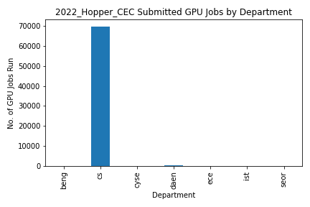
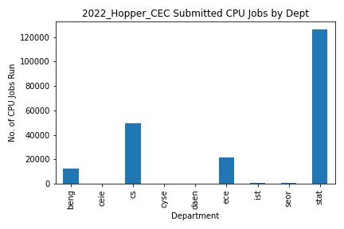
Hopper CPU jobs by Department in CEC : 2022
Department | Dept | Hopper 2022 GPU Runs | College
Department of Bioengineering | BENG | 206 | CEC
Department of Computer Science | CS | 69808 | CEC
Department of Cyber Security Engineering | CYSE | 19 | CEC
Data Analytics and Engineering | DAEN | 274 | CEC
Department of Electrical and Computer Engineering | ECE | 82 | CEC
Department of Information Sciences and Technology | IST | 141 | CEC
Department of Systems Engineering and Operations Research | SEOR | 16 | CEC
 | Total | 70546
Department | Dept | Hopper 2022 CPU Runs | College
Department of Bioengineering | BENG | 12714 | CEC
Department of Civil, Environmental, and Infrastructure Engineering | CEIE | 11548 | CEC
Department of Computer Science | CS | 284762 | CEC
Department of Cyber Security Engineering | CYSE | 53 | CEC
Data Analytics and Engineering | DAEN | 427 | CEC
Department of Electrical and Computer Engineering | ECE | 64094 | CEC
Department of Information Sciences and Technology | IST | 1791 | CEC
Department of Mechanical Engineering | ME | 7 | CEC
Department of Systems Engineering and Operations Research | SEOR | 1560 | CEC
Department of Statistics | STAT | 253527 | CEC
 | Total | 630483

